Slide 1


Case of the Killer robot Division : The MillenNial five
Detectives ASSIGNED:
Shreeya Shakya
Sukant Rajkarnikar
Sumnima Rajbanshi
Utkrista Acharya
Yubika Shrestha

Slide 2










WHAT WENT DOWN?
May 17, 1992
Silicon Techtronics
Randy Samuels Programs CX30
Arm went haywire and decapitated operator
Faulty Program?
Bart Matthews(Deceased)
Prime Suspect
Jane McMurdock(Prosecution)
charges Randy guilty

Slide 3

The crime-scene
Blood smeared all over
Decapitated head of bart Matthews
num lock not on
Numeric key pad bloody
Pointing out a desperate attempt

Slide 4

OUR Response
Clues laid out way beyond jurisdiction
Media involvement, but with new developments
Media content not admissible in the court
Unorthodox approach, working with what we had
Thorough analysis of facts in hand
Seeking the who’s the what’s and why’s

Slide 5



The Who’s
Robbie (Killer Robot):
Went haywire to decapitate it’s operator.
Bart Matthews(Deceased):
CX-30 operator. Killed by Robbie.
Randy Samuels (Prime Suspect):
Programmer of killer Robbie CX-30.

Slide 6



The who’s
Sam Reynolds:
CX-30 Project Manager.
Ray Johnson:
Chief of robotics division
Jane McMurdock:
Prosecutor indicting Randy Samuels.

Slide 7


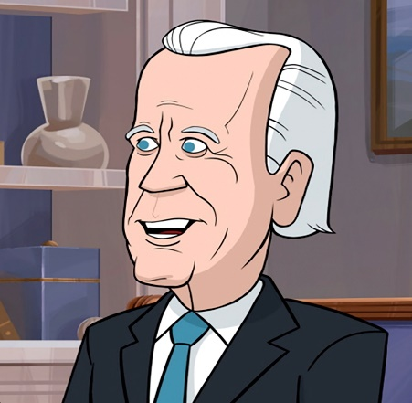
The who’s
Martha (Anonymous alias):
insider informant.(nitty-gritty)
Jane Anderson(Former Programmer):
Opposer of Reynold’s Waterfall model
Michael Waterson
CEO Silicon Techtronic’s

Slide 8
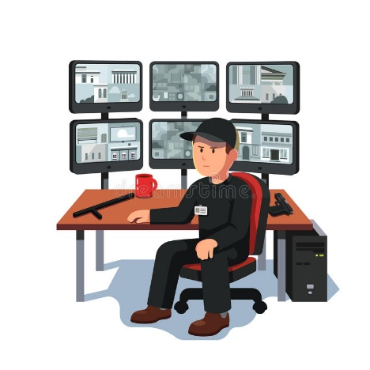

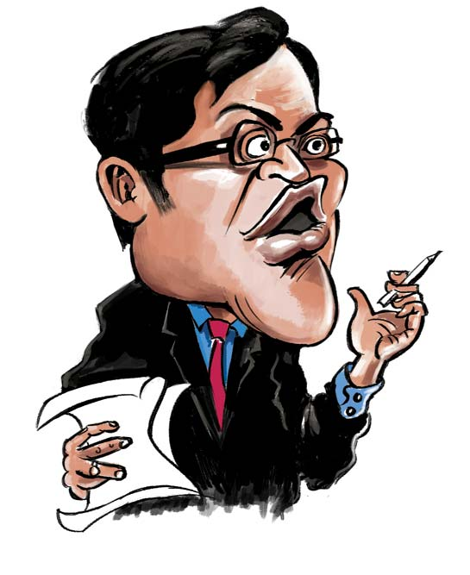
The who’s
Max Worthington(Chief of security)
monitored emails among employees
Cindy Yardley(Software tester)
responsible for testing
Harry Yoder (Professor)
Samuel Southerland Professor(Ethics)

Slide 9



The who’s
Prof. Wesley Silber:
Professor who analyzed software test
Mabel Muckraker:
special investigative reporter
Bill Park:
professor and expert in C language

Slide 10





Who/What to be indicted?
The programmer that programmed faulty software?
The Entity known as the Robotics Division?
Silicon Techtronics?
The Robot?
Any employee at the company?

Slide 11
Ground’s for Randy's indictment
McMurdock revealed faulty line of code
Presence of 3 similar formulas
Bill Park identified fault at glance
Average taken instead of derivative
Not able to take in criticisms(arrogant)

Slide 12
Time to dig deep into the matter

Slide 13
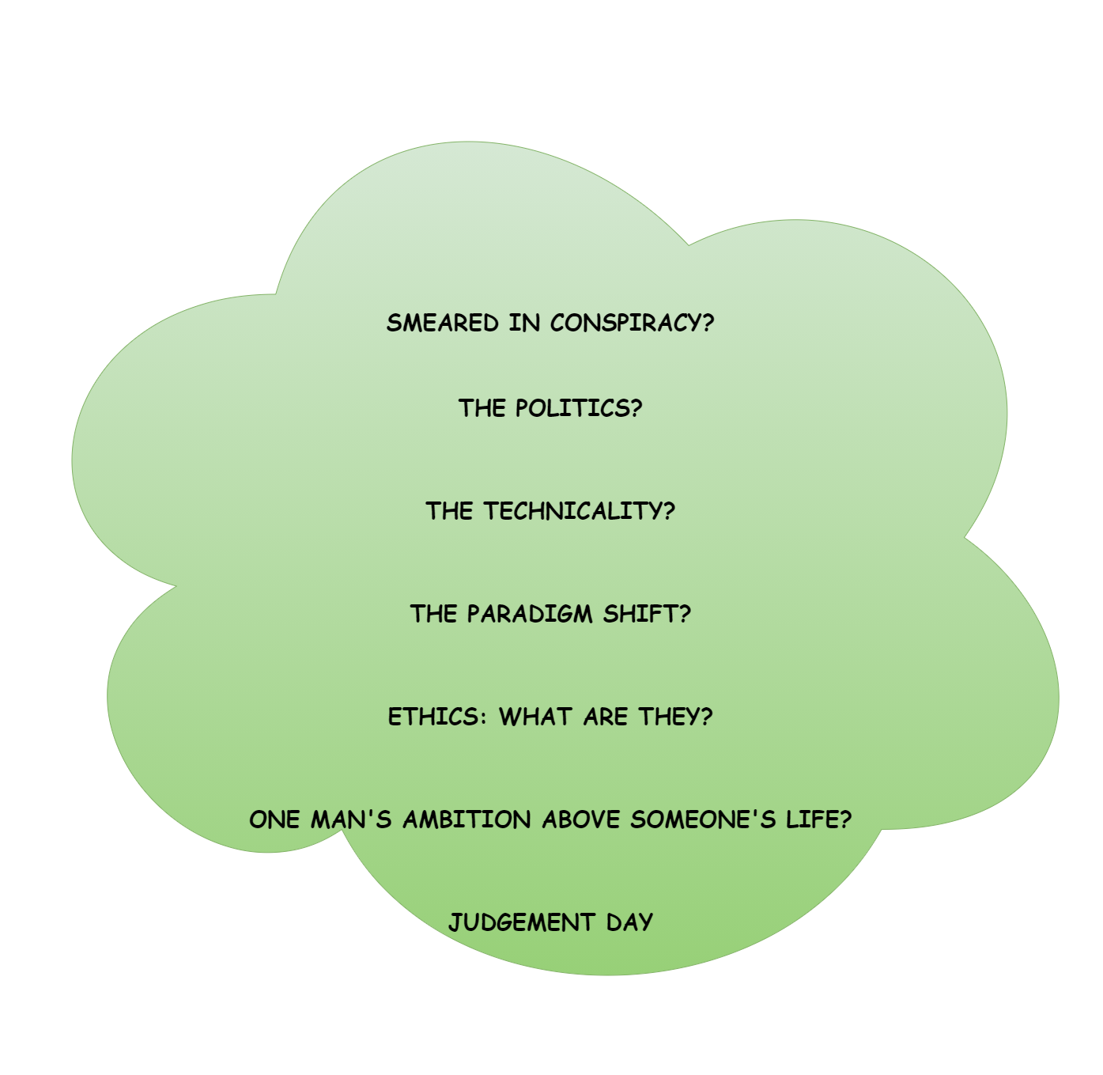





Slide 14

The conspiracy angle
Almost everyone questioned
Most pointing finger at Randy(Scapegoat)
Some terming Randy as Prima Donna
Prosecution manipulating it as open-shut case
Cut throat argument over waterfall vs prototype model
Jan Anderson fired for favoring prototype modelling

Slide 15

The Political Angle
Lump sum contribution made by Waterson(CEO)
To McMurdock(Prosecution) reelection campaign
A desperate attempt of saving face
Marking all employees expendable
Attempts to manipulate facts

Slide 16

The technicality angle
Faulty design with lack of proper input device
Cluttered user interface losing track
Even basic tasks required a trip through the manual
Error message was green when it should’ve been red
Sandra seeing CX30 gone through rigorous testing
But discrepancies data accumulated vs recorded

Slide 17
The technicality angle
The project was doomed since its inception
Leaps and bounds from previous iterations
Waterfall model implemented(no proper testing)
Underestimating the need for proper UI

Slide 18
Violation of Schneiderman's eight golden rules
Consistency above all(proper color coding)
Pinpoint errors and provide appropriate solutions
Identification of beginning and the end
Provision for shortcut for power users
The provision for undo and redo
Satisfaction that he’s the one in control(machine)
User friendly toning down user memory burden

Slide 19

In light of new developments

Slide 20

The hustle(A paradigm shift)
Pressurized to meet the deadline
Sparkling friction between Ray and Sam
Ray hiring 20 new programmers(last minute hiring)
Sam Reynolds to robotics division to cut cost
Undermining the level of sophistication of CX30
Driven by the ivory snow theory

Slide 21
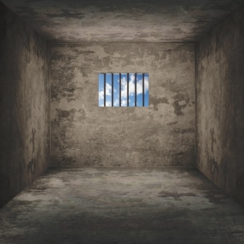


So who is guilty?
Ray Johnson

Slide 22

BCS Code of conduct
Governing body responsible maintaining ethics.
Binds all, irrespective to position.
Promotes healthy and non discriminatory work environment
No-one untouchable in case of violation

Slide 23


Why and on what grounds?
Violation of BCS Code of Conduct:
2A:
Only take work within professional competence
2F:
Avoid injuring others with your negligence.
2G:
Will not make offer of unethical inducement.

Slide 24
Why and on what grounds?
Violation of BCS Code of Conduct:
3B:
Avoid situation that causes Conflict of interest.
3E:
Shall not withhold information of product
4B:
Seek to improve professional standard.

Slide 25

THANK YOU

